Slide 1
Estimate WBGT
Using Ta, RH, SR, WS

Slide 2
Method 1
Translate the program of Excel VBA into R script
Calculate Twb, Tg
WBGT = 0.7 * Twb + 0.2 * Tg + 0.1 * Ta

Slide 3
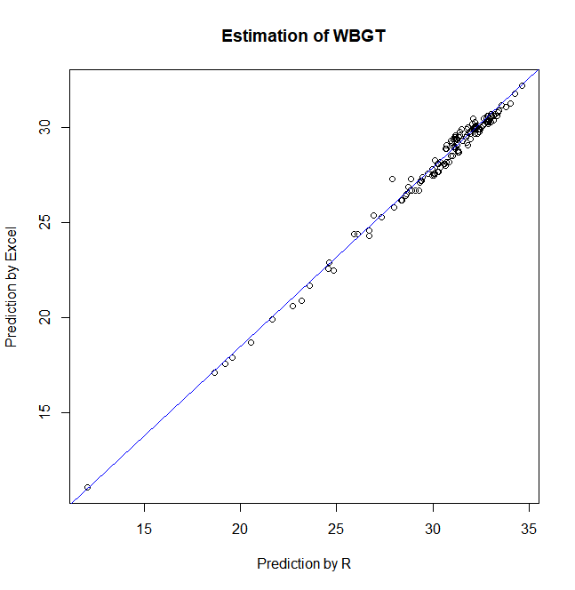
WBGT

Slide 4
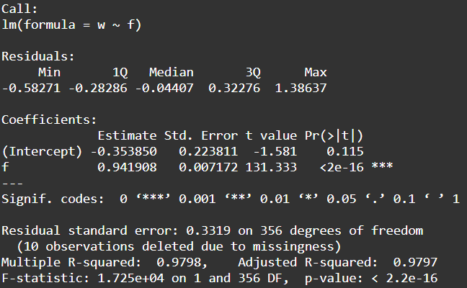
Linear regression model of WBGT (Excel~R)
Intercept = - 0.35
Slope = 0.94

Slide 5
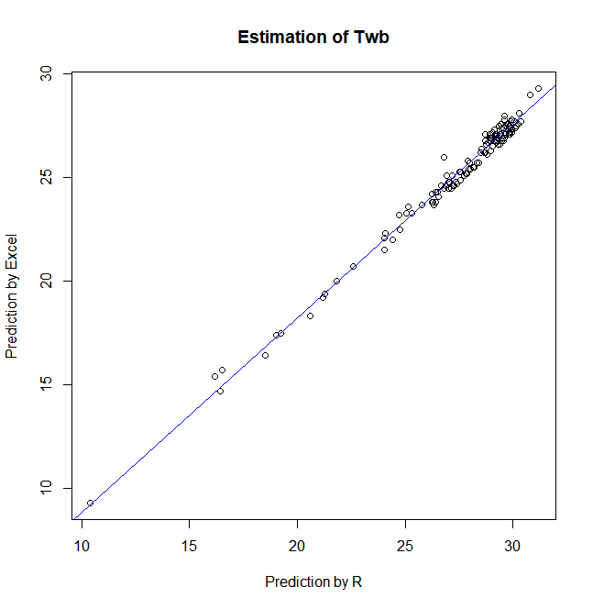
Twb

Slide 6
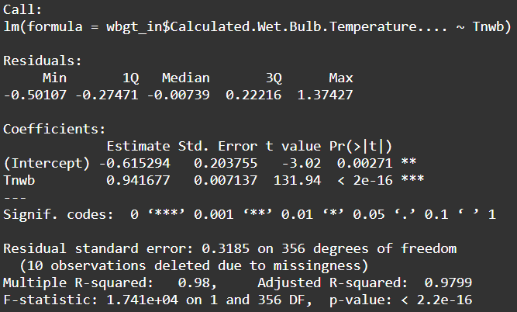
Linear regression model of Tg (Excel~R)
Intercept = -0.62
Slope = 0.94

Slide 7
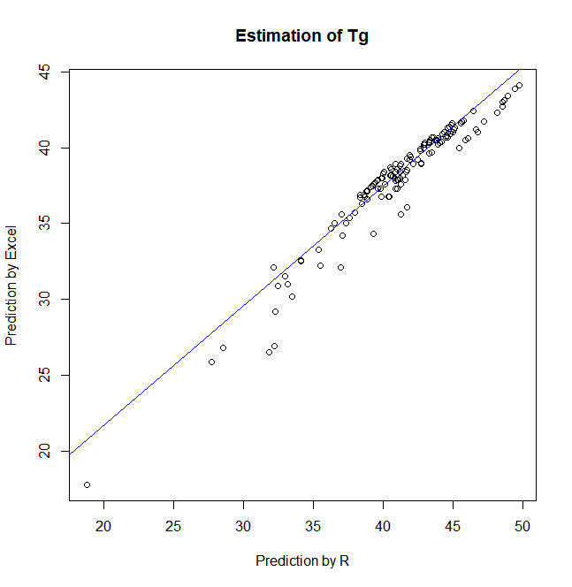
Tg

Slide 8
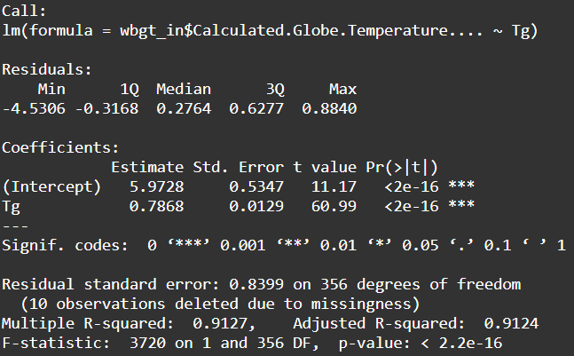
Linear regression model of Tg (Excel~R)
Intercept = 5.97
Slope = 0.79

Slide 9
Method 2
ESI = 0.63 * Ta - 0.03 * RH + 0.002 * SR + 0.0054 * (Ta * RH) - 0.073 * ((0.1 + SR) ^ (-1))
T_{a} : ambient temperature (°C)
RH : relative humidity (%)
SR : solar radiation (W·m⁻¹).
An environmental stress index (ESI) as a substitute for the wet bulb globe temperature (WBGT)

Slide 10
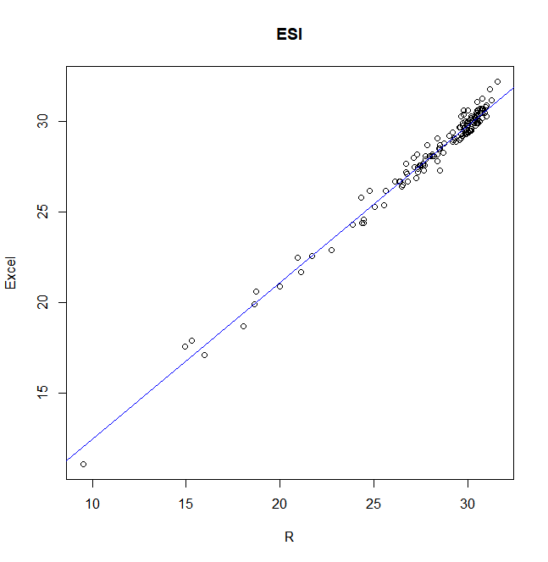
ESI

Slide 11
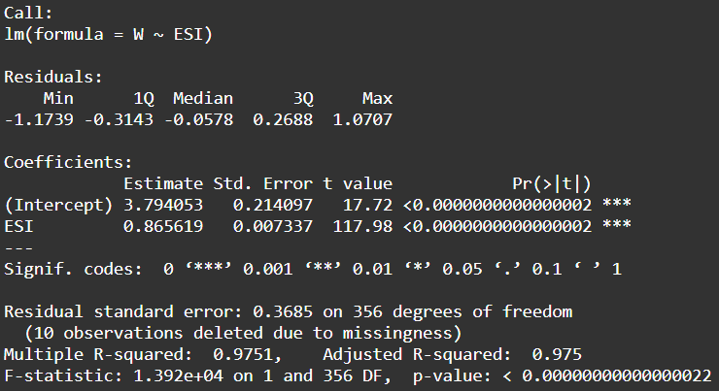
Linear regression model of WBGT (Excel~ESI)
Intercept = 3.79
Slope = 0.87

